Slide 1


The Ultimate Dream Team
CANADIAN PREMIER LEAGUE

Slide 2

TABLE OF CONTENTS
01
BACKGROUND
02
RESEARCH QUESTION
03
OVERVIEW
04
MOTIVATION
05
METHODOLOGY
06
CONCLUSION

Slide 3
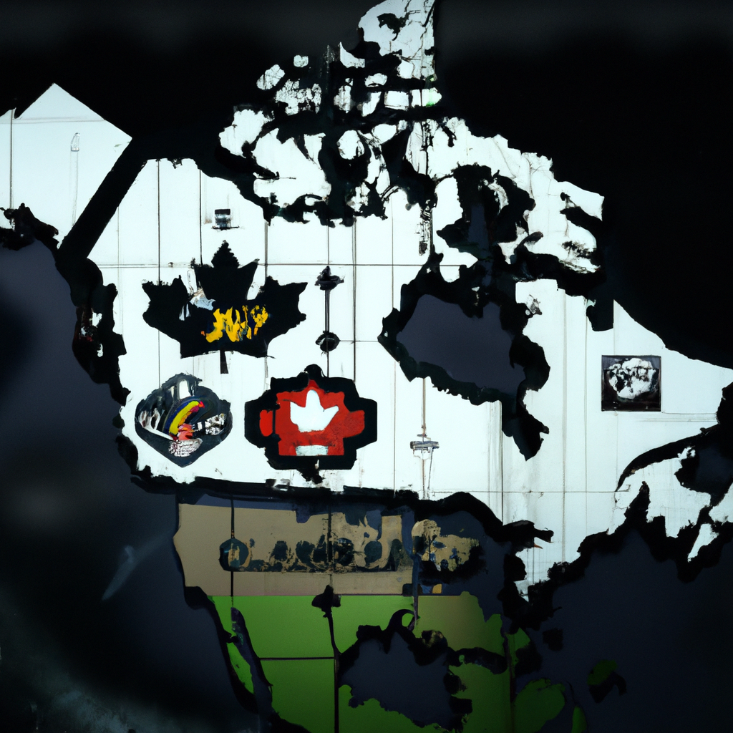
BACKGROUND
The Canadian Premier League (CPL) is a professional soccer league in Canada that was founded in 2017. The league consists of seven teams from different cities across the country, and it aims to develop Canadian soccer talent while providing fans with high-quality entertainment.
As the CPL entered its second season in 2019, many fans were excited to see how the league would evolve and which players would stand out as the top performers. In this presentation, we will analyze the CPL dream team for the 2019 season using Python and Power BI to gain insights into which players had the most impact on their respective teams.

Slide 4

RESEARCH QUESTIONS
Our analysis will aim to answer the following research questions:
What insights can we gain from analyzing the data in Python & Power Bi
Developing KPIs to find the Dream Team
Who were the top performing players in CPL during the 2019 season

Slide 5

OVERVIEW
To conduct our analysis, we collected data on all the players who participated in the 2019 CPL season, including their positions, goals scored, assists, chances created and interceptions, and so on. We then used Python to clean, preprocess and analyze the data before loading it into Power BI for visualization .
Using Power BI, we created an interactive dashboards that allowed us to explore the data in various ways, such as comparing players' performances across different metrics and visualizing team statistics. These dashboard provided us with valuable insights into which players stood out during the 2019 season and helped us make our Dream Team..

Slide 6

MOTIVATION
Our motivation for conducting this analysis was twofold. First, we wanted to showcase the power of using Python and Power BI together to gain insights into complex datasets. Second, we wanted to provide CPL fans with a deeper understanding of which players and teams had the most impact during the 2019 season.
By analyzing the data using Python and Power BI, we were able to identify trends and patterns that would have been difficult to discern otherwise. Our hope is that this analysis will spark further discussion and debate among CPL fans about the best players and teams in the league.

Slide 7
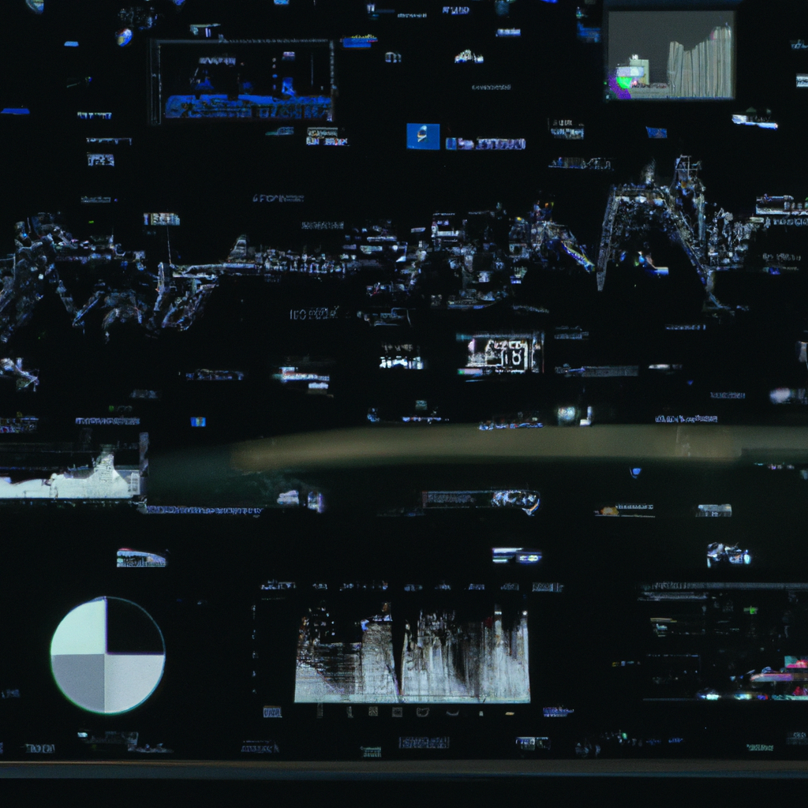
METHODOLOGY
To conduct our analysis, we first collected data on all the players who participated in the 2019 CPL season from CPL’s official website. We then used Python to clean and preprocess the data, removing any duplicate or irrelevant entries and built KPIs to find the best player in each position.
Then to find the top players in each position we wrote and if function that reads a CSV file containing information about football players, calculates a score for each player based on their KPIs, sorts the players by their scores in descending order, and returns the top players based on the input argument.
Then we loaded it into Power BI and created several interactive dashboards that allowed us to visualize and analyze the data in various ways. and to identify trends and patterns that could inform our analysis.

Slide 8

CONCLUSION
In conclusion, our analysis of the CPL Dream Team for the 2019 season using Python and Power BI has provided us with valuable insights into which players had the most impact during the season. We identified several standout players who excelled in multiple metrics, such as Tristan Borges of Forge FC, who led the league in goals scored and assists.
Our analysis also revealed that some teams performed better than others based on player performance, with Forge FC and Cavalry FC emerging as the top teams overall. Overall, our analysis demonstrates the potential of using Python and Power BI together to gain deeper insights into complex datasets and inform decision-making in sports and other fields.

Slide 9
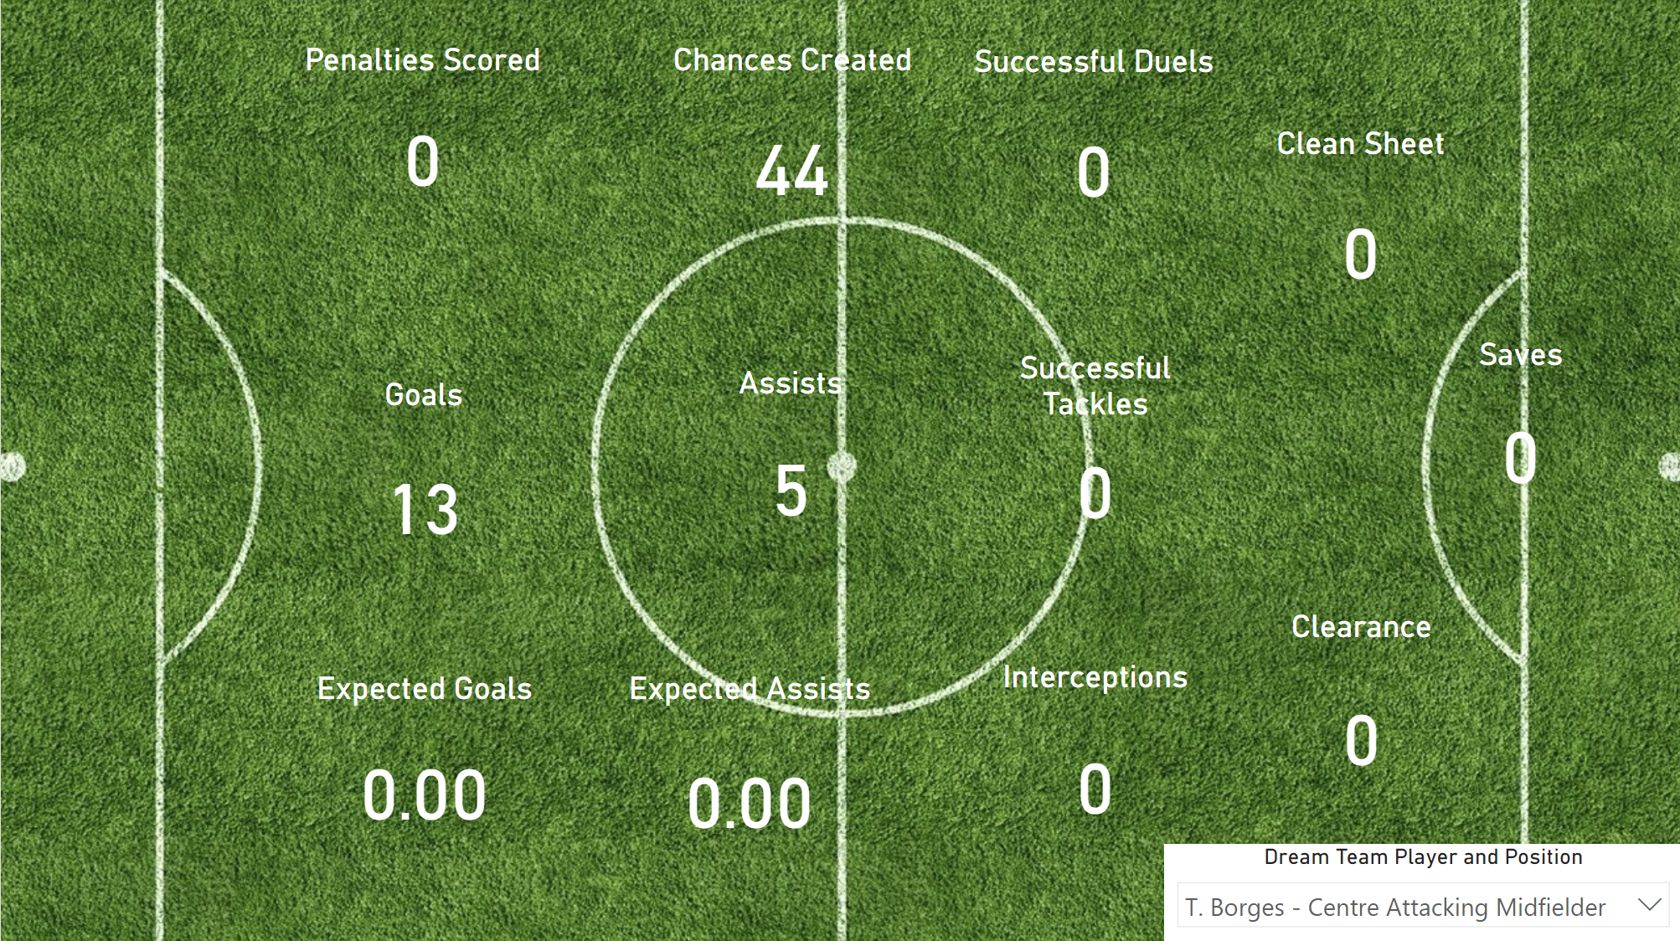
DASHBOARD

Slide 10

Mucha gracias esto es paras vosotros!

